Slide 1
Vrijdag 1 maart 2024
Shrinking space for civil society in Europe

Slide 2
welkom
Wifi: Aeropolis meetingcenter
Paswoord: meet0579
Vertaling naar Engels: kanaal 3
Translation to Dutch: channel 1

Slide 3
welkom
Liesbeth De Winter – Beweging.net
Bart Verhaeghe – De Federatie

Slide 4
programma
10u – Krimpt de ruimte voor het middenveld in Vlaanderen?
Stijn Oosterlynck (UA)
10u30 – Key trends in civic space in Europe
Alexandrina Najmowicz (Secretaris-generaal van European Civic Forum)
11u00 - Current European levers for an effective Civil Society?
Mathieu De Poorter (president CEDAG)
pauze
11u45 - Politieke reflectie
Kathleen Van Brempt (Vooruit), Thomas Jans (Groen) en Liesbet Sommen (cd&v)
12u30 - Broodjeslunch

Slide 5
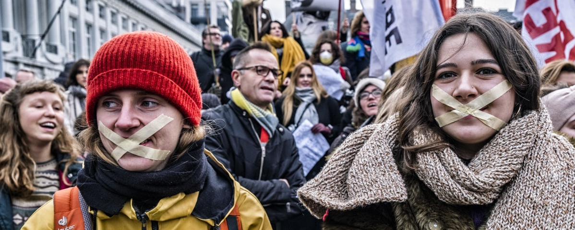
Krimpt de ruimte voor het middenveld in Vlaanderen? Prof. Dr. Stijn Oosterlynck Departement Sociologie Centre for Research on Environmental and Social Change & Antwerp Urban Studies Institute Stijn.Oosterlynck@uantwerpen.be

Slide 6
Overzicht
Ruimte voor het middenveld
België, een netwerksamenleving
Krimpende ruimte voor het middenveld?

Slide 7
Ruimte voor het middenveld
middenveld gaat in essentie over zelforganisatie van burgers
om aan gemeenschapsvorming te doen
dienstverlening aan te bieden
belangen te verdedigen en/of sociale verandering en innovatie na te streven
diepe historische wortels (bv. gilden), maar ‘modern’ fenomeen: ontstond toen ‘staat’ en ‘markt’ zich als aparte maatschappelijke sfeer ontwikkelden
Notes:
Niet gewoon ruimte die ze innemen, het is ruimte die ze afdwongen.
VOORBEELDEN TOEVOEGEN

Slide 8
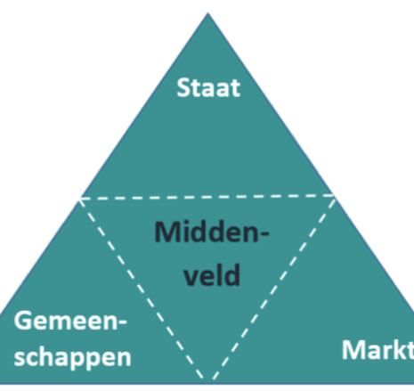
Ruimte voor het middenveld
geen restruimte, maar eigen ‘project’: normativiteit (missie-gedreven) en collectiviteit (burgers organiseren zich samen)
middenveld creëert actief ruimte tussen staat, markt en individuele burgers
voortdurend in beweging: burgerinitiatieven, sociaal ondernemerschap, stedelijke participatie- diensten, …

Slide 9
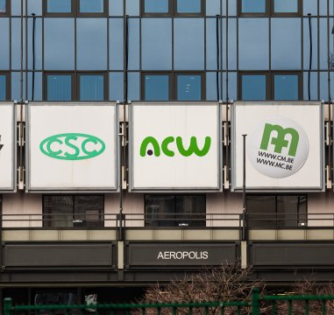
België, een netwerksamenleving
België heeft sterke traditie van zelforganisatie
wortelt in katholieke geschiedenis: via (katholieke) sociale voorzieningen en verenigingen kon Kerk aanwezig blijven in seculariserende samenleving – compromis tussen Kerk en staat
resulteerde in verzuiling, aangezwengeld door groei van welvaartstaat en sociaal overlegmodel
ontzuiling vergrootte ruimte voor marktwerking: zuil worden politieke concerns (cfr. Huyse)

Slide 10
België, een netwerksamenleving
resulteerde in zwakke Belgische staat: middenveld controleert expertise, heeft implementatiecapaciteit, rechtstreeks toegang tot/loyaliteit van doelgroep
verzwakken van zuilorganisatie (niet noodzakelijk van middenveldorganisaties zelf) en groei van niet-verzuild middenveld geen breuk met zelforganisatietraditie
bv. groei zelforganisaties van etnische minderheden
minder geïnstitutionaliseerde overlegvormen met staat
langzame erosie van centrumpartijen maakt staat ook minder stabiel als centrum van macht

Slide 11
Krimpende ruimte?
problematiek van ‘shrinking space for civil society’: ruimte van zelforganisatie van burgers ingenomen door staat en marktactoren
voorbije decennium, internationale tendens, maar sterker in autoritaire regimes, elders graduele erosie
vooral focus op staat als bedreiging voor zelforganisatie door burgers
indicatoren: controle overheid op vorming en functioneren van verenigingen en mate van participatie van burgers in verenigingen (cfr. Anheier, Lange & Toepler, 2019)

Slide 12
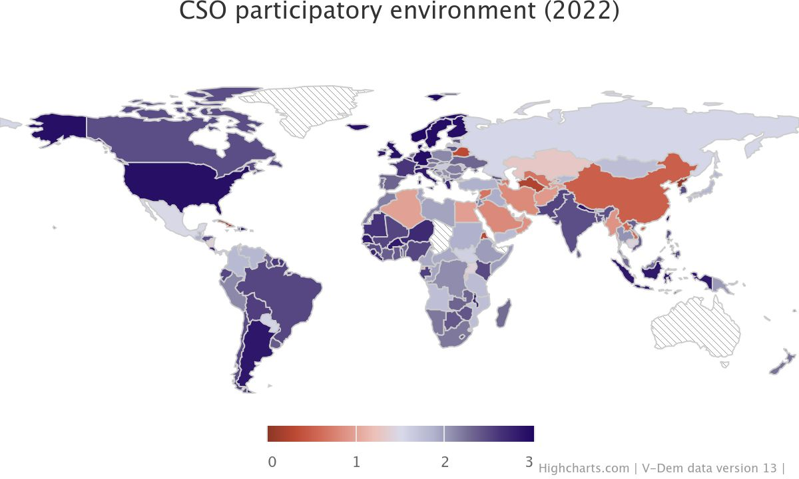
Krimpende ruimte?
V-dem CSO indices: België scoort hoog, enkel daling bij controle over entry/exit (‘minimale controle, juridisch strikt afgebakend en gecontroleerd wordt’, versus VS)
participatieve omgeving: veel organisaties en normaal om af en toe te participeren in minimum één organisatie (score 3, België: 2,85)
Zelf proberen? https://www.v-dem.net/data_analysis/MapGraph/
Notes:
https://www.v-dem.net/data_analysis/MapGraph/

Slide 13
Krimpende ruimte
algemene cijfers vertellen niet alles (wel dat ruimte voor middenveld elders veel kleiner is)
- vergelijken met andere landen of met vroeger?
ruimte voor middenveld ook hier onder druk:
- vermarkting (bv. residentiële ouderenzorg)
- verstaatsing (bv. integratiesector)
- staatsingrijpen op autonoom initiatief (bv. koepel van federaties van ECM omgezet in ‘participatie-organisatie’; oprichting SAM vzw)
Notes:
https://www.v-dem.net/data_analysis/MapGraph/

Slide 14
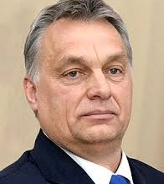
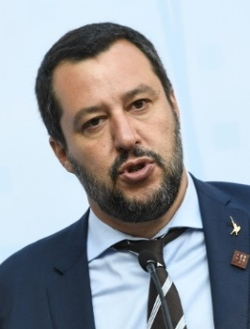
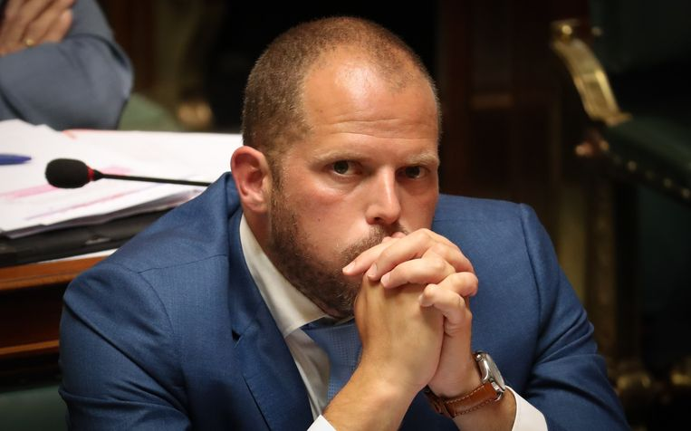
Krimpende ruimte?
opkomst ‘illiberalisme’: achter formeel democratische instellingen en procedures gaan ondemocratische praktijken schuil
versterking uitvoerende macht, met opgang van autoritaire leiders die spreken vanuit ‘volk’ (nauw afgebakende gemeenschap)
‘machtsdeling’ in netwerksamenleving, met oa. middenveld, ondergraven door spreekrecht van alternatieve machten aan te vallen (‘niet aan politiek doen’, ‘subsidieslurpers’, …)

Slide 15
Krimpende ruimte?
vooral rond ‘migratie’ en ‘etnisch-culturele minderheden’ krimpt ruimte voor middenveld
aanpassing Decreet Sociaal-Cultureel Volwassenenwerk: organisaties ‘die zich terugplooien op etnisch-culturele afkomst’ geen subsidies meer geven
communicatie organisaties over conflict in Midden-Oosten screenen
wat als Vlaams Belang aan macht komt?

Slide 16
Concluderend
België is netwerksamenleving, met sterk middenveld en relatief zwakke overheid
in vergelijking met buitenland veel ruimte voor middenveld, maar wel tendensen van bedreiging
sterktes kunnen zwaktes worden als middenveldsonvriendelijke partijen aan macht komen: overlegmodel en overheidsubsidies
heeft middenveld alternatieve strategieën om ruimte voor zelforganisatie te behouden en uit te bouwen?

Slide 17
Key trends in civic space in Europe
Alexandrina Najmowicz (Secretaris-generaal European Civic Forum)

Slide 18
Key trends in civic space in Europe
Resistance to shrinking democratic space

Slide 19
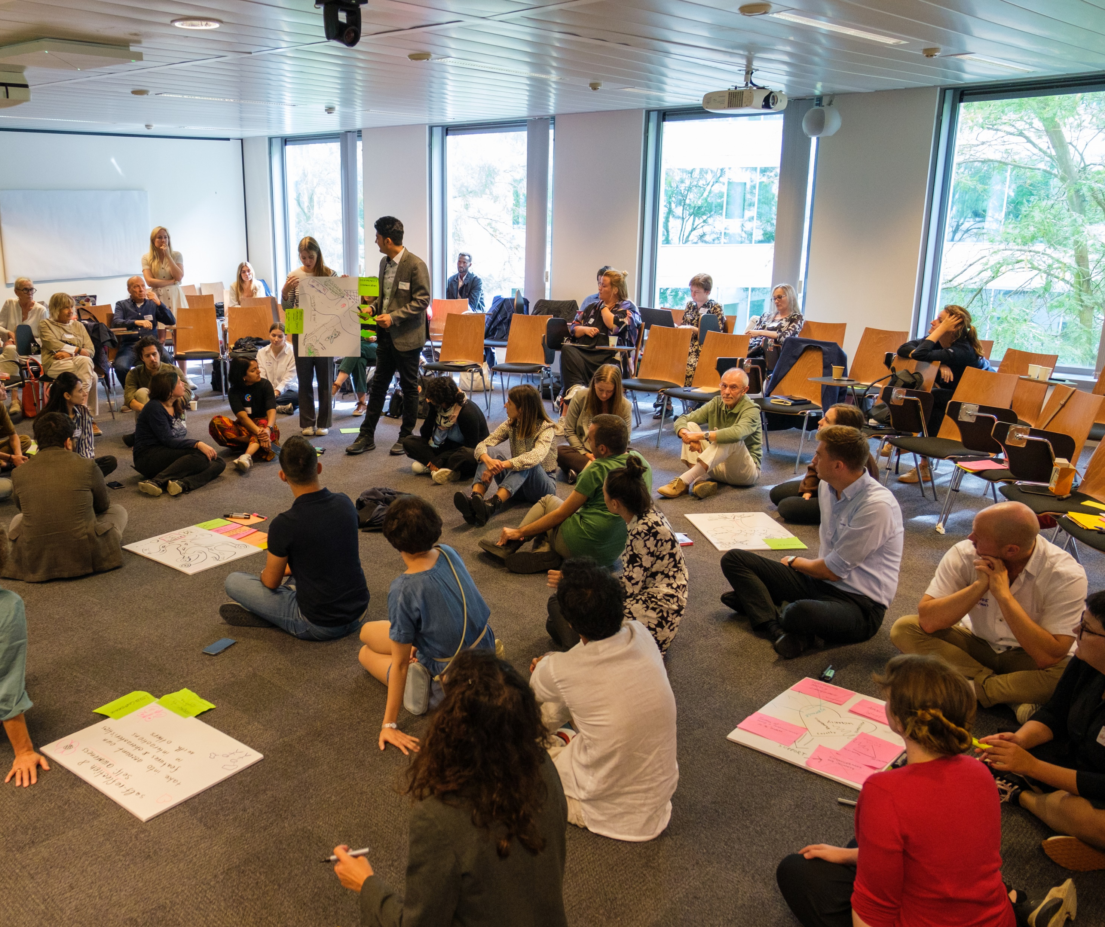
About the ECF
European Civic Forum (ECF) is a pan-European network of more than 100 associations and NGOs across 29 European countries founded in 2005
Working to protect civic space, enable civic participation and build civil dialogue for more equality, solidarity and democracy in Europe

Slide 20
What is civic space?
Six pillars of civic space:
A conducive institutional, political and socio-economic landscape
The respect of civic freedoms: a supportive legal and regulatory framework for civic freedoms, in particular freedoms of association, peaceful assembly and expression
Safe space and state duty to protect
A supportive framework for CSOs’ financial viability and sustainability
The dialogue between civil society and governing bodies
Civil society’s resilience to challenges to democracy, rule of law and fundamental rights
The political, legislative, social and economic environment that enables people to come together, share their interests and concerns and act to shape their societies.
Open civic space is the cornerstone of democracy and the rule of law.
Protection by EU and international law: Art. 2 & 11 of TEU, EU Charter for Fundamental rights and UN guidelines

Slide 21
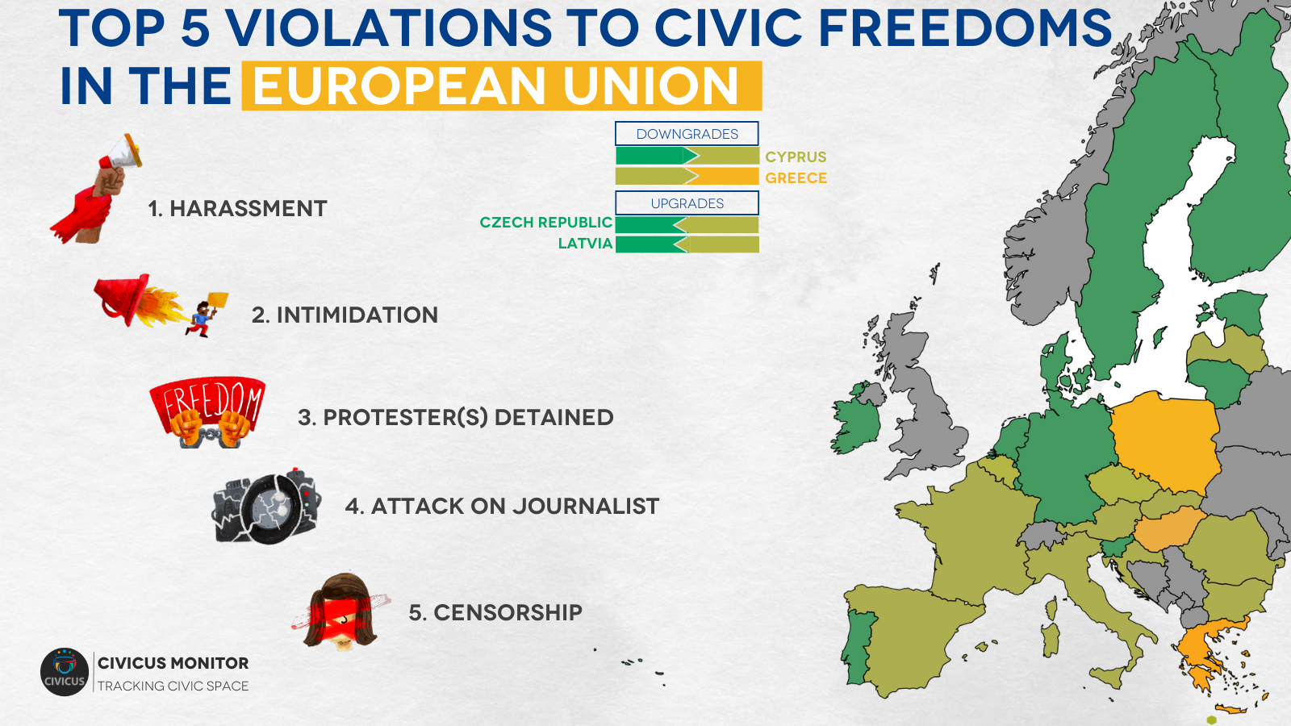
Civic space in EU
Over the last few years, civil society organisations (CSOs), human rights defenders (HRDs) and grassroots movements have raised concerns over the rapid deterioration of democratic processes, civic freedoms and adherence to the rule of law in several EU member states.

Slide 22
Key developments and trends (i)
Socio-economic and political landscape:
Civil society steps up in Solidarity with Ukraine: uneven interactions with authorities
Economic consequences of Russia’s aggression risks feeding societal polarisation
Discriminated groups remain under pressure

Slide 23
Key developments and trends (ii)
These measures often mark a shift from recognising freedom of association as a means to ensure social cohesion and democracy, to looking at civil society as entities that are presumed guilty of foreign interference, lack of transparency or smuggling and that need to be supervised and, sometimes, restricted under the guise of promoting transparency and security.
Regulatory environment for civic freedoms:
Restrictive laws hampering CSOs
Narratives that legitimise restrictive legislation at national level have been echoed in the European institutions
Laws curbing the right to protest

Slide 24
Key developments and trends (iii)
Safe Space
Defenders at risk: smear campaigns, attacks and legal harassment
Criminalisation of solidarity
Repressions on protests: Intimidation, harassment, detentions

Slide 25
Key developments and trends (iv)
Funding for civil society:
Availability of public funding for the civic sector to engage in rule of law and fundamental rights
Lack of transparency in how funds are awarded (political control)
Political attacks on funding
Administrative and bureaucratic burden

Slide 26
Key developments and trends in (v)
Civil dialogue and right to participation:
Despite existing mechanisms, the implementation of civil dialogue and participation of CSOs in the policy-making at national level is often “ad hoc”, “informal”, or “tokenistic”.
Public consultations, which are often the main avenue for civil society to provide input on proposed legislation, are considered to be less effective than other mechanisms.
In the absence of a structured policy framework and guidelines across EU institutions, practices and the level of engagement vary depending on the sensitivity of civil servants.

Slide 27
Key developments and trends in (vi)
CSOs push back in trying times:
Despite the shrinking space for civil society across several member states, organisations continue to demonstrate resilience and positive impact.

Slide 28
Tackling shrinking civic space as a European phenomenon The state of play

Slide 29
Towards a European civic space (1)
Political recognition
Annual rule of law report with country specific recommendations
Annual FRA reports; European Parliament reports on shrinking civic space and the European statute for associations; LIBE Monitoring group on democracy rule of law and fundamental rights
Upcoming European Commission civic space report, OECD report and Swedish Presidency conclusions on civic space
Legal environment
Lack of definition and legal form
Impact of EU law on civic space (DSA, state aid, internal market and competition rules, anti-money laundering and countr-terrorism laws…)
Study on associative laws and Directive for European cross-border associations
Infringement procedures: CJUE rulings recognise that laws obstacles to access foreign funding and criminalisation of solidarity in Hungary infringe EU law

Slide 30
Towards a European civic space (2)
Framework for CSOs’ financial viability
CERV → under review
Co-funding, bureaucracy, unit costs and lump sums
National barriers to access funding
New civil society programme of the EU and Norway grants
Civil dialogue and participation mechanisms
Vice-President in charge for maintaining civil dialogue and safeguarding the right of peaceful assembly and the freedom of association
Lacks policy framework and basic standards; emphasis on citizens’ consultation over civil dialogue
Recommendations on civil society engagement
Protection
SLAPP Directive and complementary Recommendation to Member States

Slide 31
Towards a European civic space (3)
Shrinking civic space attempts at the EU level
Election in the European Economic and Social Committee
French government interference with the disbursement of funding under the CERV
European Parliament approves amendment criticising the EU commission for allegedly financing campaigns promoting the hijab and radical religious and political organisations, and calling to impose to the beneficiary organisations of the CERV programme the signature of a Charter committing them to respect EU values
Italy, Malta, Cyprus and Greece sent a joint letter asking NGOs to "comply" with the "international legal framework of search and rescue operations“
Pieper report on transparency of funding for NGOs
Defence of democracy package

Slide 32
Looking ahead: European elections

Slide 33
Civil Society for EU
A pan-European campaign, run by Civil Society Europe and Social Platform, with the support of CSOs including ECF, calls for:
European Civil society Strategy
Civil Dialogue Agreement

Slide 34
Thank you! ☺ For more info: https://civic-forum.eu/
www.civicspacewatch.eu anajmowicz@civic-forum.eu

Slide 35
Current European levers for an effective Civil Society?
Mathieu De Poorter (president CEDAG)

Slide 36
Mathieu de Poorter, President, CEDAG 1st March 2024, Brussels (BE)
Shrinking space for civil society in Europe conference Current European levers for an effective Civil Society?

Slide 37
Few words about CEDAG
CEDAG - European Council for associations of general interest (Comité européen des associations d’intérêt général) : European network that provides a voice for the non-profit sector at the European level on specific issues which are common to all non-profit organizations and associations
Objectives
Structure associations in Europe as providers of services of general interest and actors of the civil society
Bridge national association with EU institutions on topics such as social economy, social services, EU fundings, the recognition of non-profit organisations, the role of associations in civil dialogue and in civil society
Means
Membership within the EU
EU projects (e.g. EU fundings)
European mandates : CEDAG is founding member of Social Economy Europe and of Social Services Europe, as well as a member of the Social Platform
Notes:
social fields of activities
like education, citizenship, culture, social and health issues, environmental issues, consumer
protection and sport,

Slide 38
What is on the table of the EU ?
Context
Geopolitical issues and foreign interferences
Suspicion with NGOs/CSOs; e.g. Qatargate, Anti-money laundering Directive & Ultimate Beneficial Owners (UBO) national register, Derisking strategies of Banks with discrimination of associations (BE), etc.
87% Europeans consider civil society as important in promoting and protecting democracy and common values (Eurobarometer, 2023)
Disengagement of citizens’ participation in our democracies vs. Other forms of engagement?
Various EU enabling environment framing and support opportunities for CSOs
EU Elections : European Democracy Action Plan and the Defence of Democracy package, …
Social economy package & Recognition of Non-Profit Organisations (NPOs): EC Action plan with Council Recommendation on social economy framework condition & Directive on European cross-border associations (ECBA), …
Territorial cooperation: Macro Regional Strategies, …
Youth: EU Youth Strategy & the European Youth Week 2024, …
Fundings: Citizens, Equality, Rights and Values (CERV) programme, Interreg, Erasmus+, Creative Europe, etc.
Notes:
Qatargate with the role of the NGO Fight Impunity,

Slide 39
European Elections – Defence of Democracy Package
EC adoption in December 2023
3 EU instruments:
Proposal for a Directive establishing harmonised requirements in the internal market on transparency of interest representation carried out on behalf of third countries
Various issues: more registers (!), impacts on funding, administrative burden, golden plating, fees, etc.
Positive outcomes: developing civic spaces and citizens’ participation, safeguarding fundamental rights and stigmatisation of CSOs, harmonised transparency requirements, etc.
Recommendation on inclusive and resilient electoral processes in the Union and enhancing the European nature and efficient conduct of the elections to the European Parliament
Recommendation on promoting the engagement and effective participation of citizens and civil society organisations in public policy-making processes
Aim: Promote the participation of citizens and CSOs in public policy-making to help building democratic resilience
Positive outcomes: citizen-led participatory exercises, inclusiveness, accessible digital tools, provision of a safe and enabling environment for CSOs, etc.
Notes:
Qatargate with the role of the NGO Fight Impunity,
Rec => encouragements

Slide 40
Social Economy Package – ECBA Directive proposal
Legislative process: from a Resolution of the EP for associations and non-profit organisations (NPOs) with a civil society framing to the EC Proposal for a Directive of the EP and of the Council on European cross-border associations (ECBA Directive; Sept. 2023) with a pragmatic internal market perspective
Objective: removing legal and administrative barriers for non-profit associations’ cross-border activities to promote a level playing field between associations
Proposal: additional legal form in MS national legal systems (i.e. ECBA); designed for cross-border purposes to reduce legal and administrative burden (recognition and establishment); automatic recognition in all EU MS; coexistence with other national associations; equal treatment and non-discrimination with comparable national non-profit associations.
Positive outcomes: Towards the single market for the public good; Recognition of non-profit associations; Definition of the non-profit purpose and of non-profit associations; Door opener for EU-level regulation on other non-profit organisations (foundations, mutuals) and on broader civic space issues; Simplifying administrative procedures; etc.
Various issues: Equal tax treatment (for public benefit status and cross-border philanthropy taxation), Inclusion of non-EU based-members, Recognition of foundations and mutual benefit societies
Notes:
Qatargate with the role of the NGO Fight Impunity,
Rec => encouragements

Slide 41
Civil society leverages
Inspiration: “Walks for the climate” (e.g. Youth for climate BE) on the adoption of the EU Green Deal
Policy making
Defence of democracy package: further involvement and consultation of CSOs (local, regional, national, EU) in the implementation of EU Regulations, citizens’ participation in policy making process,
EP Elections: #CIVILSOCIETYFOREU 2024 EU Elections Manifesto For better civic space and civil dialogue
Social economy: implementation of national social economy action plans, European social economy meeting (Liège/Luik, 12-13 Feb.24) with the Liège Roadmap for social economy in the EU, democratic governance of social economy enterprises
Atlantic Macroregional strategy?
Under the BeEU Presidency: EU Social Agenda 2024-2029 with the High-Level Conference: European Pillar of Social Rights (15-16 April 2024, La Hulpe/Terhulpen)
Notes:
Qatargate with the role of the NGO Fight Impunity,
Rec => encouragements

Slide 42
Civil society leverages
Consultation & Participation
Have your say portal of the EU: public consultations and feedback
ECBA Directive proposal: contributions to the EC public consultation (deadline: 8 April 2024); with the possible support of CEDAG
EU Presidencies: beEU citizen panel & dozen of decentralised citizen events (see all beEU events); HU Presidency and solidarity with HU CSOs & NPOs, …
EESC Civil Society week (4-7 March 2024) => join the session 6 “A single market for the public good” (onsite/web streamed, 6 March 16:15-17:45)
European Youth week (12-19 April 2024): 69 activities, 19 countries, >1 million participants
Support of European network
And many more…
Notes:
Qatargate with the role of the NGO Fight Impunity,
Rec => encouragements

Slide 43
Bedankt voor uw aandagt ☺
For any questions on CEDAG and this presentation:
Mathieu de Poorter, President
mathieu.depoorter@unipso.be

Slide 44
Politieke reflectie
Kathleen Van Brempt (Vooruit)
Thomas Jans (Groen)
Liesbet Sommen (cd&v)
Moderatie: Sandra Rosvelds

Slide 45
thank you!

